Slide 1

IMPACT OF CAR FEATURES
ON PRICE AND PROFITABILITY
Alankar Saxena

Slide 2
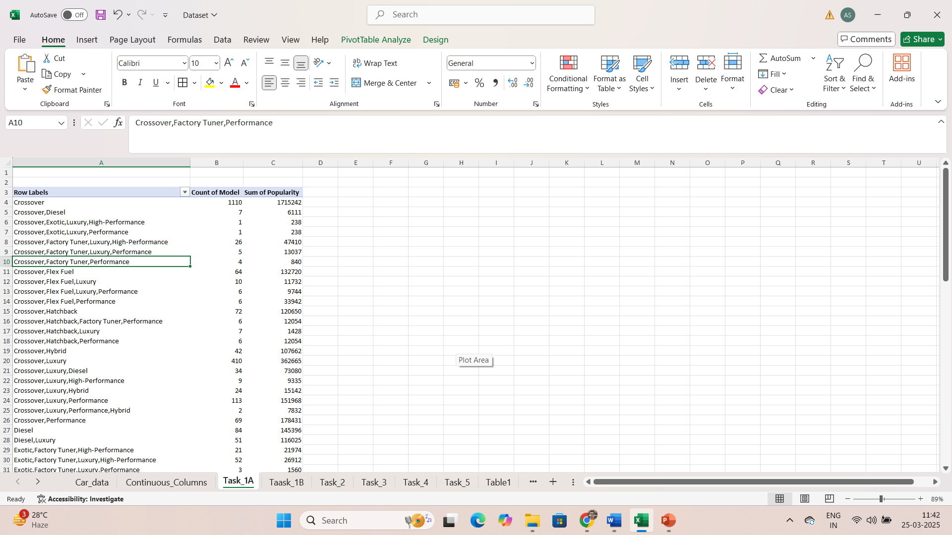
Car models v/s market category v/s popularity scores
Total count of models and sum of popularity score for particular market category is calculated and shown along with the market categories.

Slide 3
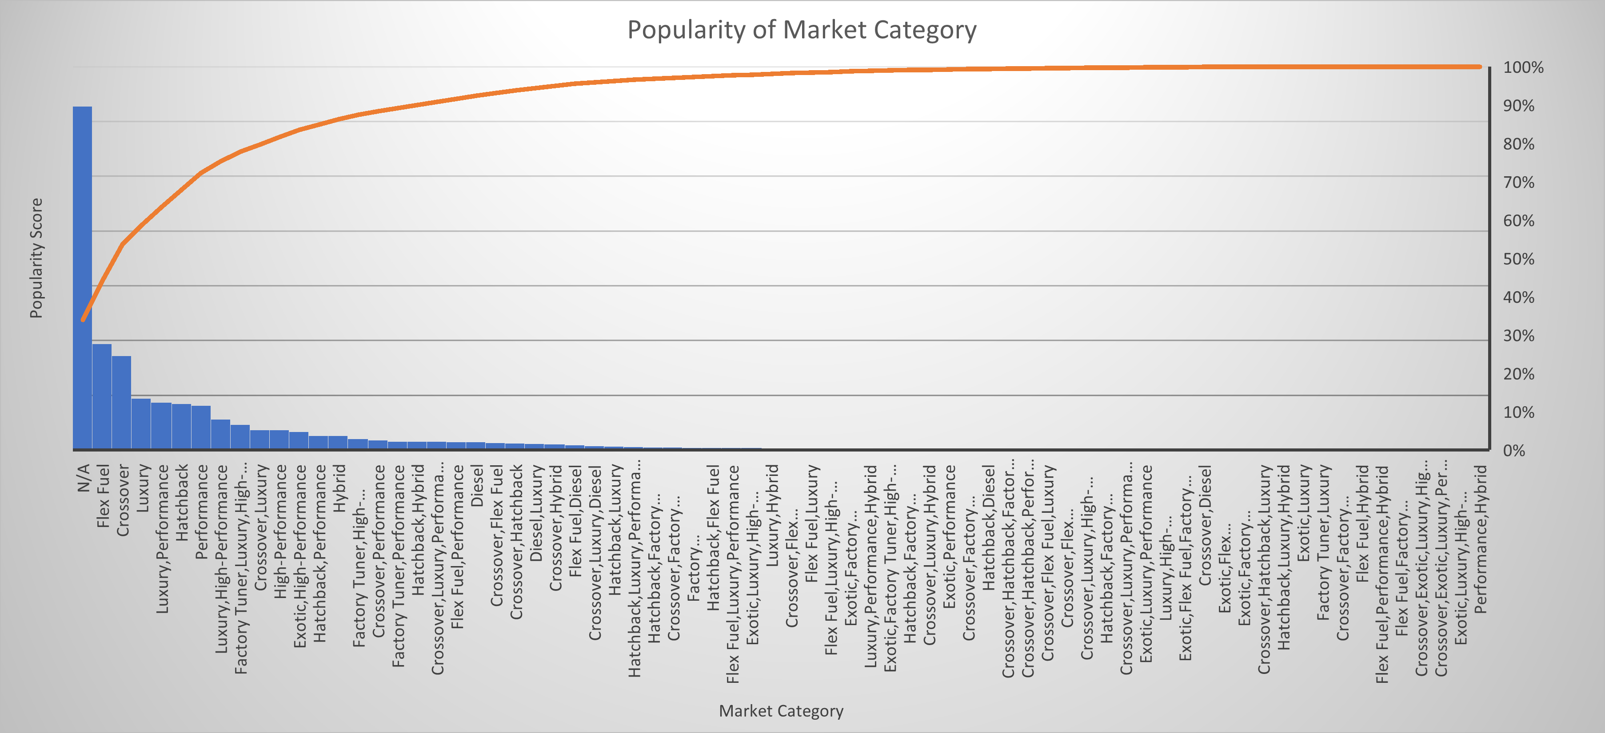
Popularity Score Of market category
Total popularity score of each market category is shown in the graph.
Data with no category available very large hence has maximum count.
First few categories contribute most to overall popularity.

Slide 4
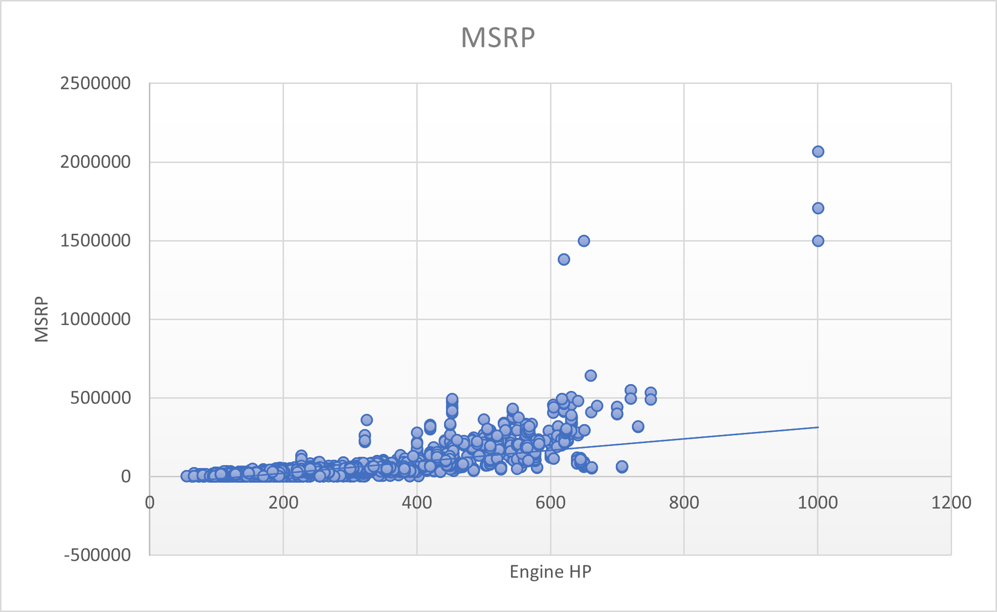
Engine Power v/s price
Engine Power and Price have positive correlation.
As the Engine Power increases, Price of the car also increases.

Slide 5
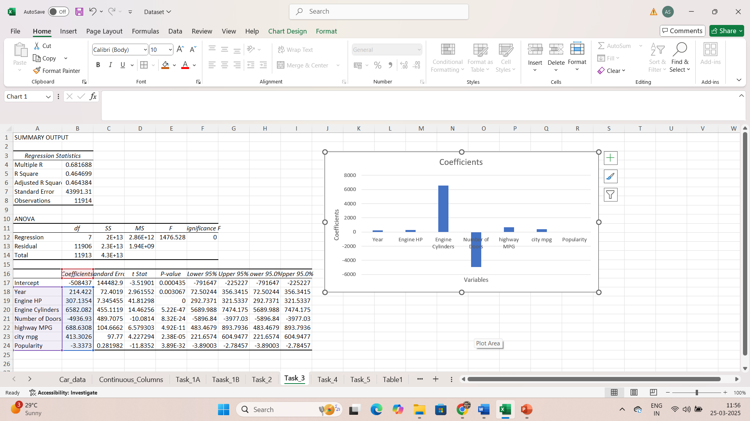
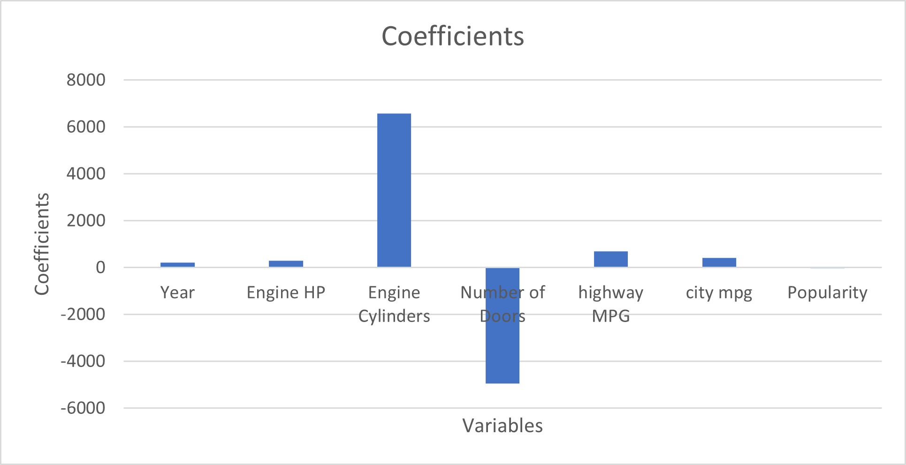
Regression analysis
Number of cylinders has the highest positive coefficient, which suggests that number of cylinders has the most impact on price.
Number of doors has negative coefficient, which suggests that it has most negative impact on price.

Slide 6
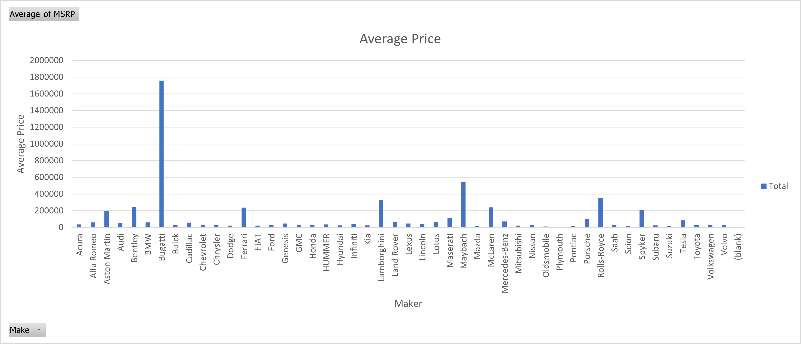
Brand v/s price
Average Price of cars for each brand is shown in the graph.
Bugatti has the highest average price among all brands while Plymouth has the lowest average price among all brands.

Slide 7
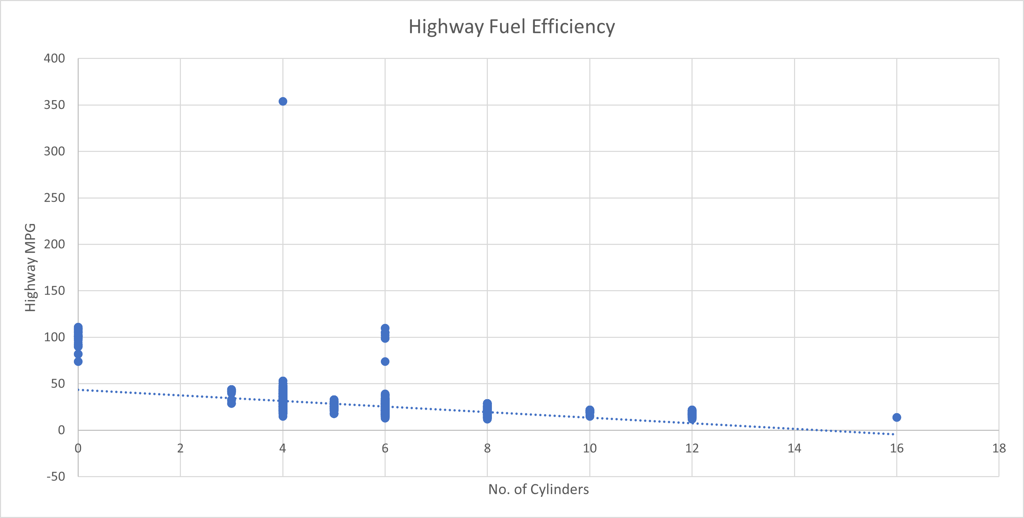
Fuel efficiency v/s no. of cylinders
Number of cylinders and Highway MPG have negative correlation (-0.60095), which suggests that as the number of cylinders increases, the fuel efficiency of the decreases.

Slide 8
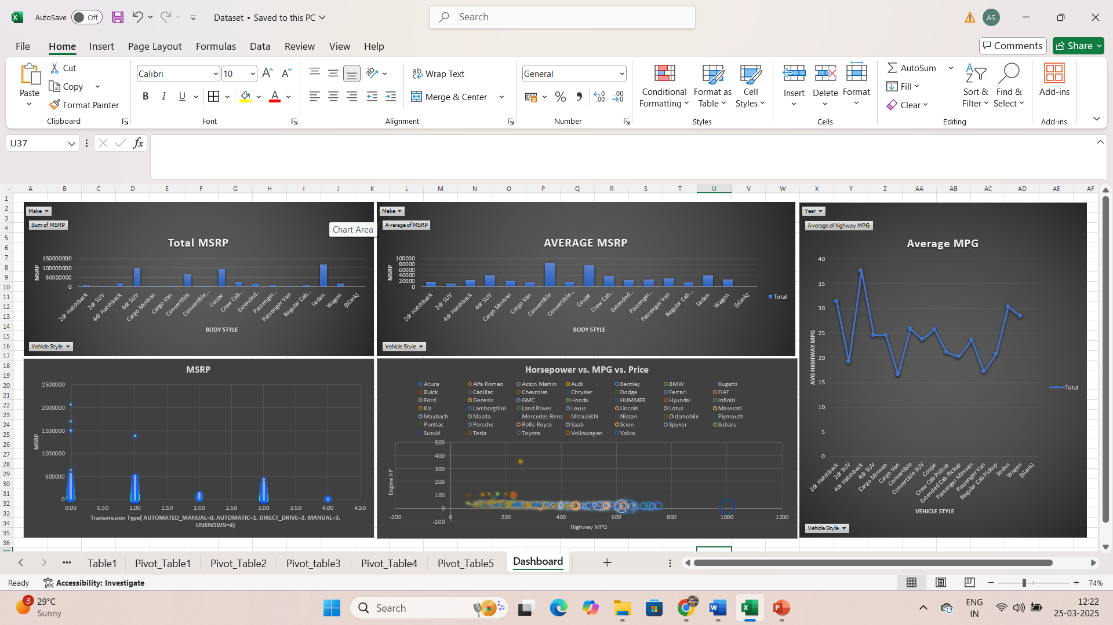
Dashboard includes Total price of each body style which can be filtered by brands, Average price of each body style which can be filtered by brands, Average price of each transmission type, Average fuel efficiency of each vehicle style which can be filtered by year and Horsepower, Fuel Efficiency and Price of each brand.

Slide 9
Link
https://docs.google.com/spreadsheets/d/1Kz0-oLWMv_dWZV6InQi032B4Ep_jNNpD/edit?usp=sharing&ouid=100987342170051497390&rtpof=true&sd=true

Slide 10
Thank you

